Slide 1
Weird and wonderful world of waste in West Suffolk
Kate McFarland CRWM
Waste Strategy Officer
West Suffolk Council

Slide 2
Waste Recycling and Street Scene Services in West Suffolk
Background
Two tier authority
Suffolk Waste Partnership
Recycling Credits
Landfill tax
HIGHLY regulated industry- due to risk to environment & human health
Compositional analyses – data driven

Slide 3
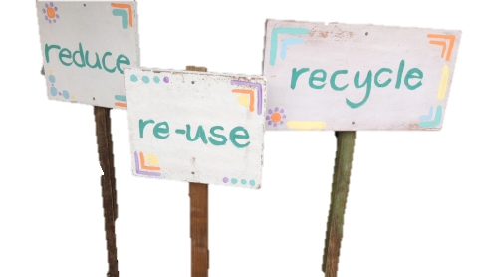
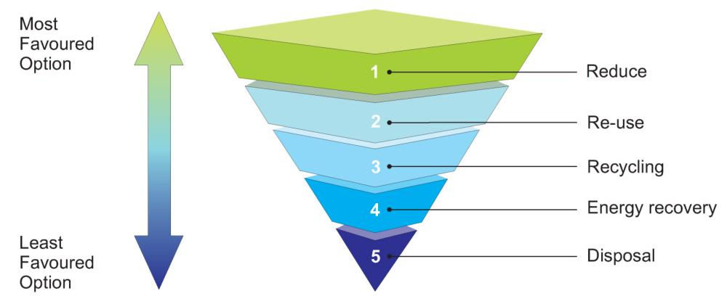
The waste hierarchy Waste Hierarchy
Most favoured option
Best for the environment
Making less rubbish!
Using things again
Making new things from old
Using waste to make energy
Landfilling what’s left
Least favoured option
Worst for the environment
Notes:
Prevention / Reduce - Buy items less packaging –fruit & veg good example-any other examples?
Reuse - If possible use item more than once, before disposing of it – clothes
Recycle - Make into another product – plastic bottles & containers make good storage for garden shed, garage + in freezer– jars for preserving & jam making
Recover – Type of disposal but gain energy from the process.
If all else fails – hopefully dust, dirt – plastic film some supermarkets now take back

Slide 4
Waste reduction and reuse campaigns in Suffolk
Food Savvy
Waste Less Save More packs
Home composting
Reuse shelters
Reusable nappies
www.suffolkrecycling.org.uk

Slide 5
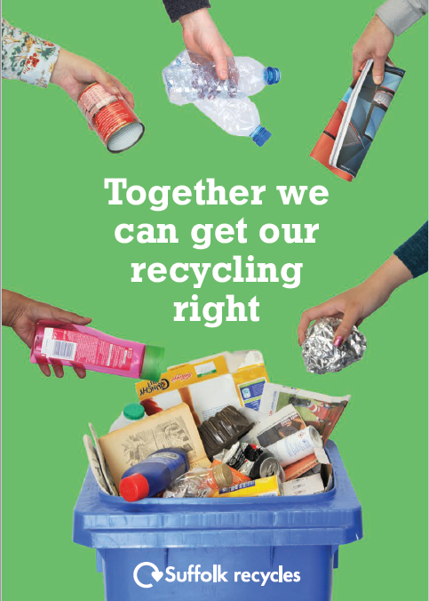
Recycling campaigns in Suffolk
Together we can get your recycling right
Aim to reduce contamination of recycling bins in Suffolk
Using proven behaviour change messaging
Wide ranging mass communication
All commonly used social media channels

Slide 6
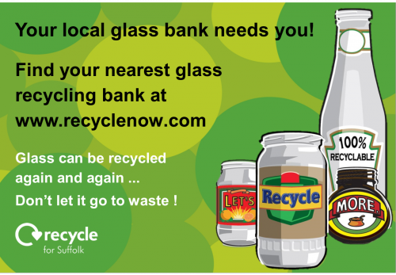
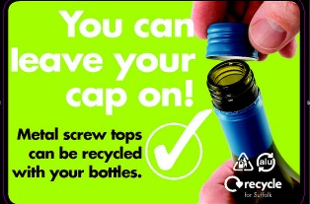
Recycling campaigns in Suffolk
Glass recycling &
metal matters
Keep your cap on

Slide 7
What happens to your recycling? The Materials Recycling Facility
Run by Viridor in Great Blakenham
Sorted by machines, magnets and people
Marketed across the world - used instead of virgin materials – where our materials are sent is published online

Slide 8
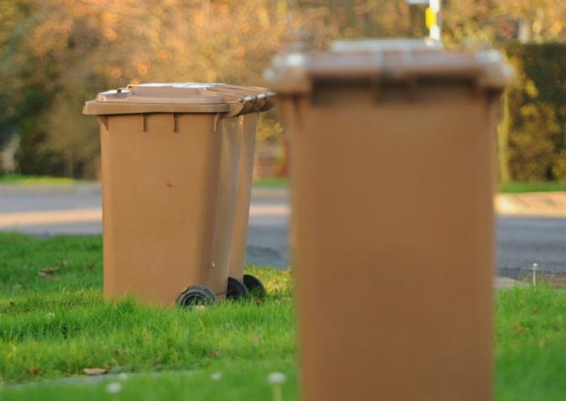
Garden Waste Collection Service
30 000 + customers at £43 per year
Reduction of 5000tn in waste system
Compost created used locally in parks and farms
dead plants and flowers
grass, leaves and weeds
hedge clippings
pruning and twigs
sawdust
small branches (not more than 6cm thick)
vegetable waste from the garden (not kitchen waste)

Slide 9
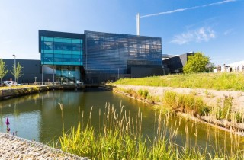
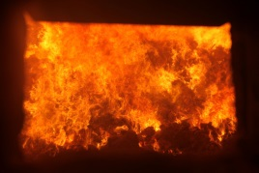
Energy recovery in Suffolk
Current disposal point is EfW in Great Blakenham
Was first discussed in 2006
Construction started in May 2012
Fully operational in December 2014
Has won multiple awards for design & construction
Has a dedicated community liaison officer offering tours…

Slide 10
Energy from Waste process
269 000 tonnes per year
Recycles – IBA & metals
Electricity for 30,000 homes
Saves £350m vs landfill
75 000 tns less greenhouse
gases

Slide 11
Street Scene Services
Love Where You Live
Nearly 1000 regular volunteers

Slide 12
Future of waste & recycling
Circular economy & Social Value
Resource management
Government Consultations on Extended Producer Responsibility, Deposit Return Scheme & Consistency in household waste collections
Investment in recycling facilities in the UK
Public awareness and perception of the industry

Slide 13
Thank you for your time happy to take some questions
Kate.McFarland@WestSuffolk.gov.uk

